Slide 1


6.819 Deep Transfer Learning for Covid-19 Detection
Xin Zeng Tale Lokvenec
xinzeng@mit.edu talelokvenec@g.harvard.edu
Notes:
Today we are going to talk about our project: universal policy for multi-objective reinforcement learning.

Slide 2
Background: Multi-Objective Reinforcement Learning
Guidance for presentations:
- what problem did you address?
- why is it interesting?
- why is it hard?
- what was key to your approach?
- how well did it work?
Notes:
Traditional RL algorithms only consider single objective. But real world problems normally involve more than one objective, such as moving speed and energy efficiency.

Slide 3

Comprehending and mitigating the low clinical sensitivity of the RT-PCR testing is pivotal to the containment of the global coronavirus pandemic.
Notes:
Traditional RL algorithms only consider single objective. But real world problems normally involve more than one objective, such as moving speed and energy efficiency.

Slide 4
Comprehending and mitigating the low clinical sensitivity of the RT-PCR testing is pivotal to the containment of the global coronavirus pandemic.
However, this can be difficult using the traditional disease detection techniques.
Notes:
Traditional RL algorithms only consider single objective. But real world problems normally involve more than one objective, such as moving speed and energy efficiency.

Slide 5
We aimed to develop a complementary method for rapid coronavirus detection from CT scans using deep transfer learning
“
Notes:
Traditional RL algorithms only consider single objective. But real world problems normally involve more than one objective, such as moving speed and energy efficiency.

Slide 6
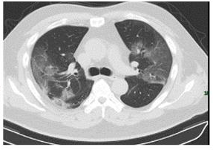
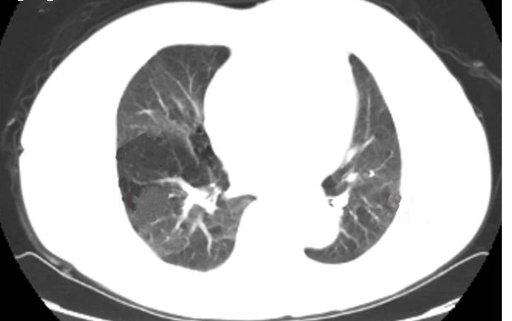
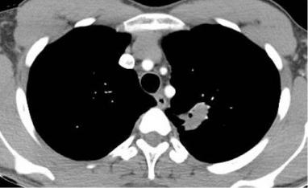
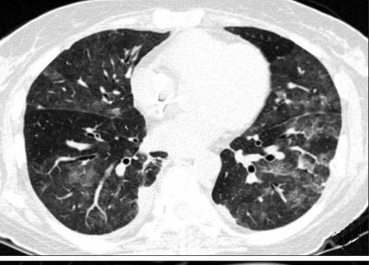
Data: Covid-CT-Dataset
Covid-19 CT
Non-Covid-19 CT
349 CT images of Covid-19 and 463 CT images of Non-Covid-19
Notes:
Traditional RL algorithms only consider single objective. But real world problems normally involve more than one objective, such as moving speed and energy efficiency.

Slide 7
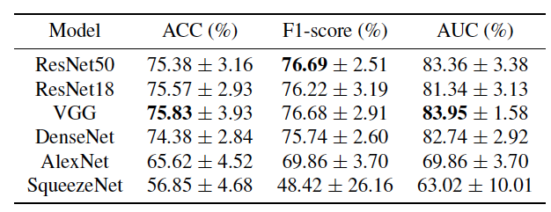
Baseline: Fine-tuning Method
Covid-CT-Dataset
Pre-trained Model
Prediction
Notes:
Traditional RL algorithms only consider single objective. But real world problems normally involve more than one objective, such as moving speed and energy efficiency.

Slide 8
Optimization 1: Mapping-based Method
Covid-CT-Dataset
Pre-trained Model
Prediction
Source Dataset
Pre-trained Model
Prediction
7593 COVID-19 images
6893 CT Non-Covid-19 images
Notes:
Traditional RL algorithms only consider single objective. But real world problems normally involve more than one objective, such as moving speed and energy efficiency.

Slide 9
Optimization 1: Mapping-based Method
Covid-CT-Dataset
Pre-trained Model
Prediction
Source Dataset
Pre-trained Model
Prediction
7593 COVID-19 images
6893 CT Non-Covid-19 images
Notes:
Traditional RL algorithms only consider single objective. But real world problems normally involve more than one objective, such as moving speed and energy efficiency.

Slide 10
Optimization 1: Mapping-based Method
Modification
Experiments
source classification loss
domain loss
target classification loss
Balance the classification loss between the labeled source and target data
Adapt to ResNet structure
FC layer
FC layer
adaptation layer
adaptation layer
ResNet (remove the last FC layer)
ResNet (remove the last FC layer)
Computation of MMD: radial basis function (RBF) kernel & linear kernel
Domain Loss Function: MMD & CORAL
source images
target images
Notes:
Traditional RL algorithms only consider single objective. But real world problems normally involve more than one objective, such as moving speed and energy efficiency.

Slide 11
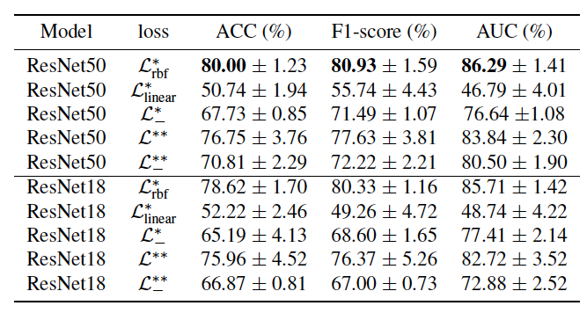
Optimization 1: Mapping-based Method
Notes:
Traditional RL algorithms only consider single objective. But real world problems normally involve more than one objective, such as moving speed and energy efficiency.

Slide 12
Optimization 2: Generative Method
Covid-CT-Dataset
Generative Method
Augmented Covid-CT-Dataset
Covid-CT-Dataset:
349 CT Covid-19 images
463 CT Non-Covid-19 images
Augmented Covid-CT-Dataset:
925 CT Covid-19 images
1039 CT Non-Covid-19 images
Prediction
Pre-trained Model
Notes:
Traditional RL algorithms only consider single objective. But real world problems normally involve more than one objective, such as moving speed and energy efficiency.

Slide 13
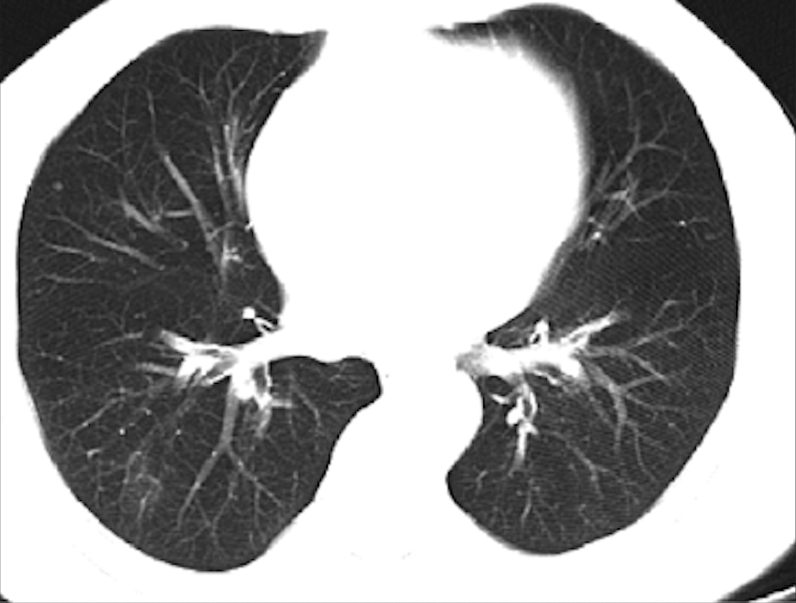

Optimization 2: Generative Method
μ
x
Encoder
Z
Decoder
x’
σ
Notes:
Traditional RL algorithms only consider single objective. But real world problems normally involve more than one objective, such as moving speed and energy efficiency.

Slide 14
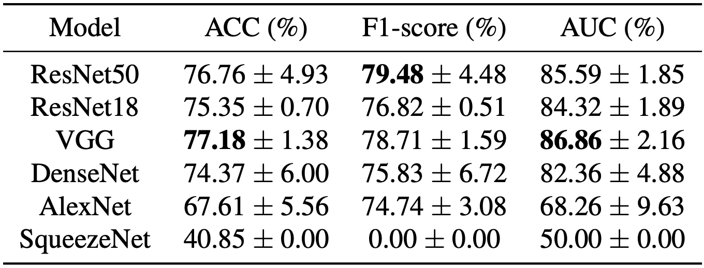
Optimization 2: Generative Method
μ
x
Encoder
Z
Decoder
x’
σ
Notes:
Traditional RL algorithms only consider single objective. But real world problems normally involve more than one objective, such as moving speed and energy efficiency.

Slide 15
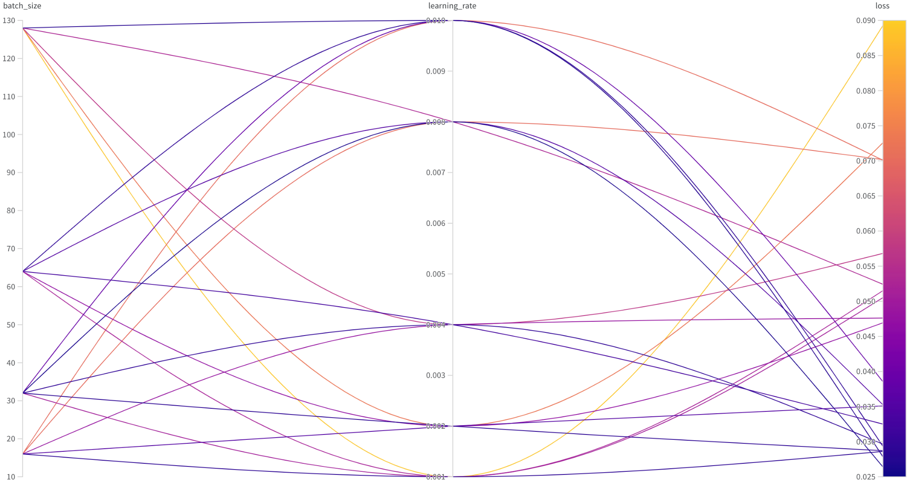
Optimization 2: Generative Method-HP Tuning
Notes:
Traditional RL algorithms only consider single objective. But real world problems normally involve more than one objective, such as moving speed and energy efficiency.

Slide 16
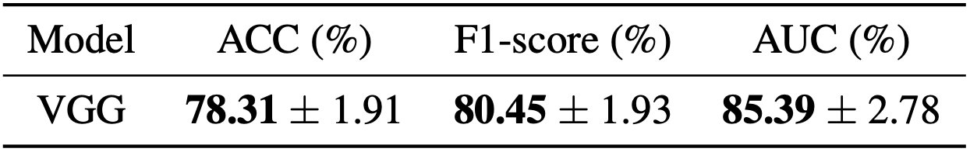
Optimization 2: Generative Method-HP Tuning
Notes:
Traditional RL algorithms only consider single objective. But real world problems normally involve more than one objective, such as moving speed and energy efficiency.

Slide 17
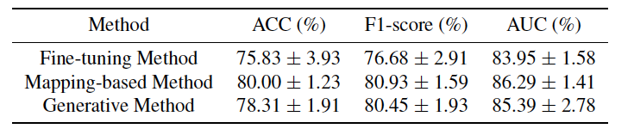
Conclusion
Both proposed optimization methods outperform the baseline in terms of all three metrics
Deep transfer learning on CT scans could be treated as a complementary method for rapid Covid-19 detection
Notes:
Traditional RL algorithms only consider single objective. But real world problems normally involve more than one objective, such as moving speed and energy efficiency.

Slide 18
Conclusion
Mapping-based method benefits from the larger size of source data and the joint loss to maintain the domain invariance
Generative method benefits from the larger size of synthetic target data through synthetic data generation
Notes:
Traditional RL algorithms only consider single objective. But real world problems normally involve more than one objective, such as moving speed and energy efficiency.

Slide 19
Thank You!
Notes:
We are happy to take any questions.

